Slide 1
Diagonalization
Hung-yi Lee

Slide 2


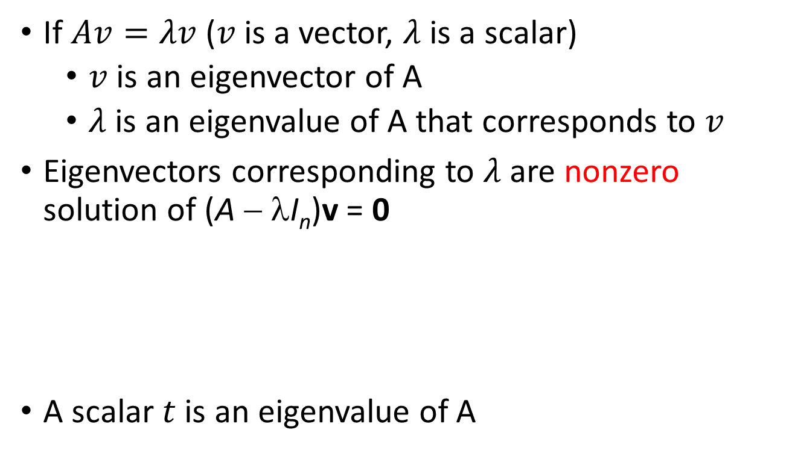



Review
If $Av=λv$ ($v$ is a vector, $λ$ is a scalar)
$v$ is an eigenvector of A
$λ$ is an eigenvalue of A that corresponds to $v$
Eigenvectors corresponding to $λ$ are nonzero solution of (A − λI_{n})v = 0
A scalar $t$ is an eigenvalue of A
excluding zero vector
Eigenvectors corresponding to $λ$
Eigenspace of $λ$:
Eigenvectors corresponding to $λ$ $\text{ + }\left\{0\right\}$
$$=Null\text{(}\text{A} \text{−} \text{λ}\text{I}\text{n}\text{)} \text{−} \left\{0\right\}$$
eigenspace
$$det\left(A−tI_{n}\right)=0$$

Slide 3

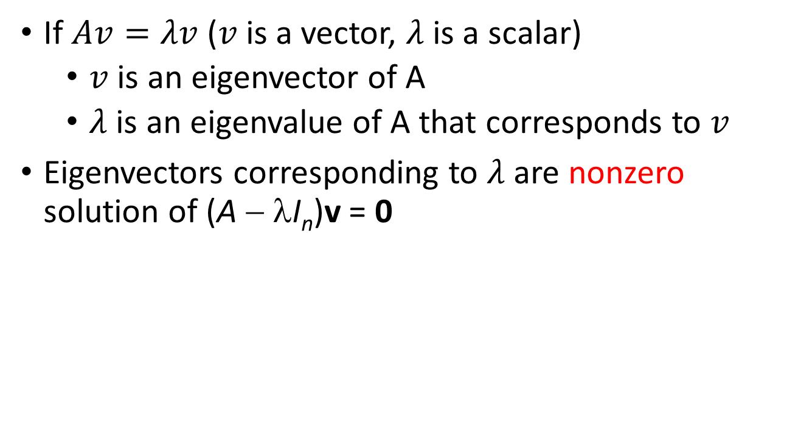








Review
Characteristic polynomial of A is
$$det\left(A−tI_{n}\right)$$
Factorization
multiplicity
$$={\left(t−λ_{1}\right)}^{m_{1}}{\left(t−λ_{2}\right)}^{m_{2}}…{\left(t−λ_{k}\right)}^{m_{k}}\left(……\right)$$
Eigenvalue:
$$λ_{1}$$
$$λ_{2}$$
$$λ_{k}$$
Eigenspace:
$$d_{1}$$
$$d_{2}$$
$$d_{k}$$
(dimension)
$$≤m_{1}$$
$$≤m_{2}$$
$$≤m_{k}$$

Slide 4
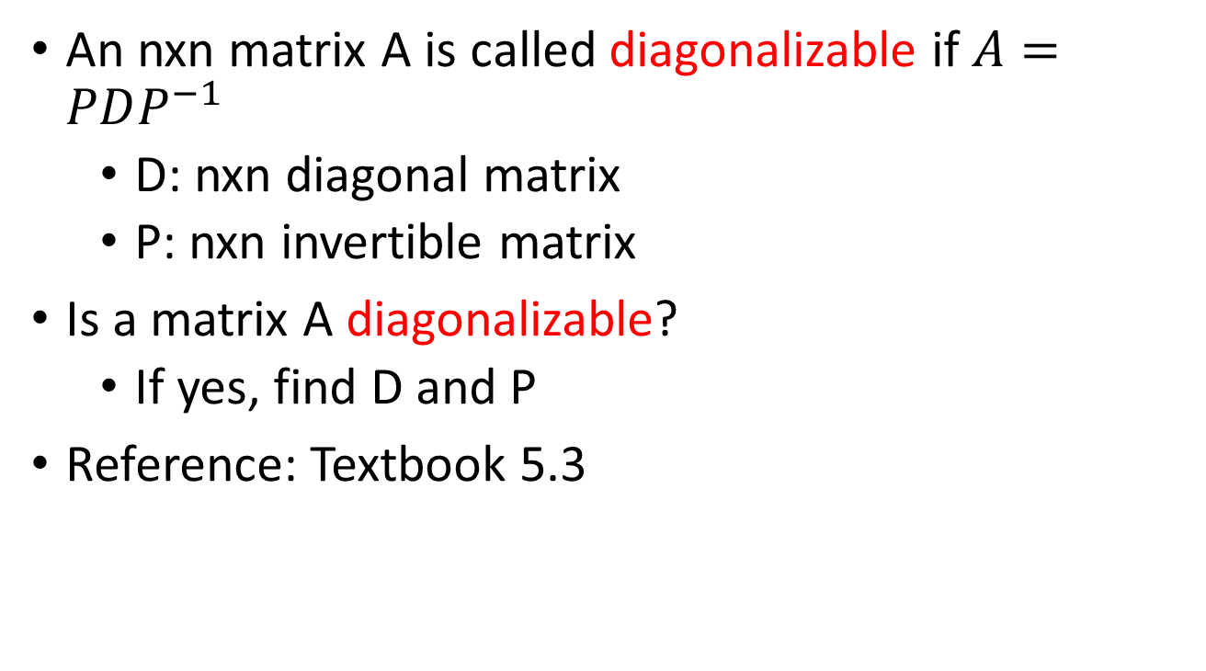
Outline
An nxn matrix A is called diagonalizable if $A=PDP^{−1}$
D: nxn diagonal matrix
P: nxn invertible matrix
Is a matrix A diagonalizable?
If yes, find D and P
Reference: Textbook 5.3
Notes:
Application 1: growth
Application 2: linear operator

Slide 5

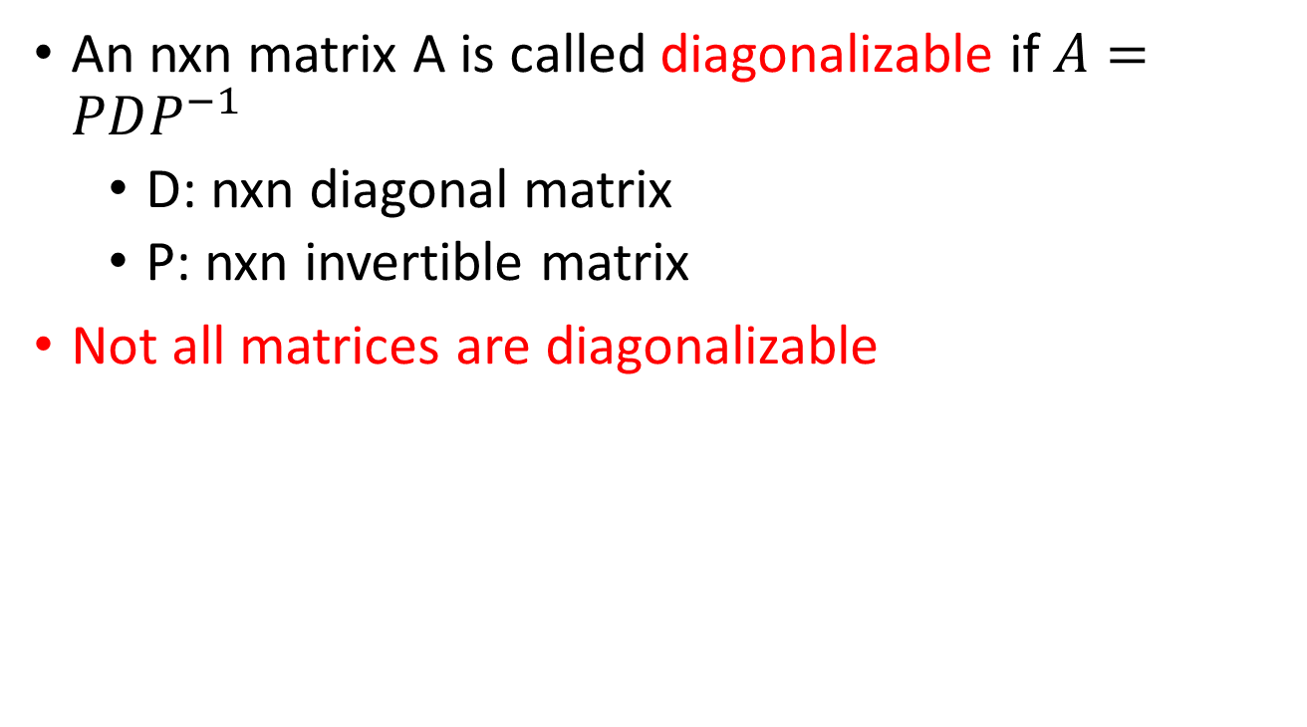
Diagonalizable
An nxn matrix A is called diagonalizable if $A=PDP^{−1}$
D: nxn diagonal matrix
P: nxn invertible matrix
Not all matrices are diagonalizable
(?)
A² = 0
If A = PDP⁻¹ for some invertible P and diagonal D
A² = PD²P⁻¹
= 0
D² = 0
D = 0
D is diagonal
A= 0

Slide 6











Diagonalizable
$$P=\left[\begin{matrix}p_{1} & ⋯ & p_{n}\end{matrix}\right]$$
$$D=\left[\begin{matrix}d_{1} & ⋯ & 0 \\ ⋮ & ⋱ & ⋮ \\ 0 & ⋯ & d_{n}\end{matrix}\right]$$
If A is diagonalizable
$$A=PDP^{−1}$$
$$AP=PD$$
$$AP=\left[\begin{matrix}Ap_{1} & ⋯ & Ap_{n}\end{matrix}\right]$$
$$PD=P\left[\begin{matrix}d_{1}e_{1} & ⋯ & d_{n}e_{n}\end{matrix}\right]$$
$$=\left[P\begin{matrix}d_{1}e_{1} & ⋯ & Pd_{n}e_{n}\end{matrix}\right]$$
$$=\left[\begin{matrix}d_{1}Pe_{1} & ⋯ & d_{n}Pe_{n}\end{matrix}\right]$$
$$=\left[\begin{matrix}{d_{1}p}_{1} & ⋯ & {d_{n}p}_{n}\end{matrix}\right]$$
$$Ap_{i}=d_{i}p_{i}$$
$p_{i}$ is an eigenvector of A corresponding to eigenvalue $d_{i}$
Notes:
P的n个column就是p1~pn
AP就是P的每个column都乘上A
d1到dn是scalar，e1~en是standard vector
每一个matrix乘上一个standard vector，就变成该matrix的一个column
d是eigenvalue，p的每个column就是eigenvector
因为p是invertible的，每个column都是independent的。我们知道任意选取的矩阵的Eigenvector，很多都可以是dependent的。
所以如果我们要对角化一个矩阵的话，我们必须找出n个independent的eigenvector

Slide 7

Diagonalizable
$$P=\left[\begin{matrix}p_{1} & ⋯ & p_{n}\end{matrix}\right]$$
$$D=\left[\begin{matrix}d_{1} & ⋯ & 0 \\ ⋮ & ⋱ & ⋮ \\ 0 & ⋯ & d_{n}\end{matrix}\right]$$
If A is diagonalizable
$p_{i}$ is an eigenvector of A corresponding to eigenvalue $d_{i}$
$$A=PDP^{−1}$$
=
There are n eigenvectors that form an invertible matrix
=
There are n independent eigenvectors
=
The eigenvectors of A can form a basis for R^{n}.

Slide 8
Diagonalizable
$$P=\left[\begin{matrix}p_{1} & ⋯ & p_{n}\end{matrix}\right]$$
$$D=\left[\begin{matrix}d_{1} & ⋯ & 0 \\ ⋮ & ⋱ & ⋮ \\ 0 & ⋯ & d_{n}\end{matrix}\right]$$
If A is diagonalizable
$p_{i}$ is an eigenvector of A corresponding to eigenvalue $d_{i}$
$$A=PDP^{−1}$$
How to diagonalize a matrix A?
Find n L.I. eigenvectors corresponding if possible, and form an invertible P
Step 1:
Step 2:
The eigenvalues corresponding to the eigenvectors in P form the diagonal matrix D.
Notes:
Is diagonalizable unique? No.
The eigen values can repeat in step 2.

Slide 9










Diagonalizable
A set of eigenvectors that correspond to distinct eigenvalues is linear independent.
$$det\left(A−tI_{n}\right)$$
Factorization
$$={\left(t−λ_{1}\right)}^{m_{1}}{\left(t−λ_{2}\right)}^{m_{2}}…{\left(t−λ_{k}\right)}^{m_{k}}\left(……\right)$$
Eigenvalue:
$$λ_{1}$$
$$λ_{2}$$
……
$$λ_{k}$$
Eigenspace:
$$d_{1}$$
$$≤m_{1}$$
$$d_{2}$$
$$≤m_{2}$$
……
$$d_{k}$$
$$≤m_{k}$$
(dimension)
Independent
Notes:
从一个eigenspace取两个eigenvector，这两个eigenvector可能独立（Av=tv，A(2v)=t(2v)），可能不独立。
对于放大的例子，比如[[2,0],[0,2]]这个矩阵，扩大两倍。但是这个变换只有一个eigenvalue，对应了无数eigenvector。
和这里的问题不一样，这里讨论的一个矩阵（一个变换）的多个eigenvalue。

Slide 10






Diagonalizable
A set of eigenvectors that correspond to distinct eigenvalues is linear independent.
Eigenvalue:
$$λ_{1}$$
$$λ_{2}$$
……
$$λ_{m}$$
Assume dependent
Eigenvector:
$$v_{1}$$
$$v_{2}$$
……
$$v_{m}$$
a contradiction
v_{k} = c₁v₁+c₂v₂+ … +c_{k−1}v_{k−1}
Av_{k} = c₁Av₁+c₂Av₂+ … +c_{k−1}Av_{k−1}
(λ_{k})
λ_{k}v_{k} = c₁λ₁v₁+c₂λ₂v₂+ … +c_{k−1}λ_{k−1}v_{k−1}
-
λ_{k}v_{k} = c₁λ_{k}v₁+c₂λ_{k}v₂+ … +c_{k−1}λ_{k}v_{k−1}
0 = c₁(λ₁−λ_{k}) v₁+c₂(λ₂−λ_{k})v₂+ … +c_{k−1}(λ_{k−1}−λ_{k})v_{k−1}
Not c₁ = c₂ = … = c_{k−1} = 0
Same eigenvalue
a contradiction

Slide 11







Diagonalizable
$$P=\left[\begin{matrix}p_{1} & ⋯ & p_{n}\end{matrix}\right]$$
$$D=\left[\begin{matrix}d_{1} & ⋯ & 0 \\ ⋮ & ⋱ & ⋮ \\ 0 & ⋯ & d_{n}\end{matrix}\right]$$
If A is diagonalizable
$p_{i}$ is an eigenvector of A corresponding to eigenvalue $d_{i}$
$$A=PDP^{−1}$$
$$det\left(A−tI_{n}\right)$$
$$={\left(t−λ_{1}\right)}^{m_{1}}{\left(t−λ_{2}\right)}^{m_{2}}…{\left(t−λ_{k}\right)}^{m_{k}}\left(……\right)$$
Eigenvalue:
$$λ_{1}$$
$$λ_{2}$$
……
$$λ_{k}$$
Eigenspace:
……
Basis for $λ_{1}$
Basis for $λ_{2}$
Basis for $λ_{3}$
Independent Eigenvectors
You can’t find more!
Notes:
从一个eigenspace里面找出最多的independent的vector，也就是basis。
如果这些所有的basis能凑到n个vector，就能被对角化了。这里面最多有n个，因为n维空间不会存在更多的。m1+m2 + …. mk<=n。因为
Is diagonalizable unique? No.
The eigen values can repeat in step 2.

Slide 12
Diagonalizable - Example
Diagonalize a given matrix
characteristic polynomial is −(t + 1)²(t − 3)
eigenvalues: 3, −1
eigenvalue 3
A = PDP⁻¹, where
B₁ =
eigenvalue −1
B₂ =

Slide 13


Application of Diagonalization
If A is diagonalizable,
Example:
$$A=PDP^{−1}$$
$$A^{m}=PD^{m}P^{−1}$$
.15
.85
Study
FB
.97
.03
……
.85
.85
Study
Study
Study
.727
.15
.85
.15
.03
……
FB
FB
.273
.97
.15

Slide 14

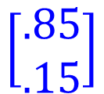





From Study FB
.15
.85
Study
FB
.97
To Study FB
.03
$$=A$$
……
.85
.85
Study
Study
Study
.727
.15
.85
.15
.03
……
FB
FB
.273
.97
.15
$$\left[\begin{aligned}.727 \\ .273\end{aligned}\right]$$
$$\left[\begin{aligned}.85 \\ .15\end{aligned}\right]$$
$$\left[\begin{aligned}1 \\ 0\end{aligned}\right]$$
$$A=PDP^{−1}$$
$$A^{m}=PD^{m}P^{−1}$$
Notes:
The following example shows that stochastic matrices do not need to be diagonalizable,
http://mathoverflow.net/questions/51887/non-diagonalizable-doubly-stochastic-matrices

Slide 15
Diagonalizable
Diagonalize a given matrix
RREF
(invertible)
RREF

Slide 16


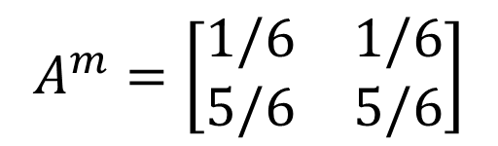

Application of Diagonalization
When $m→∞$,
The beginning condition does not influence.
$$A^{m}=\left[\begin{matrix}1/6 & 1/6 \\ 5/6 & 5/6\end{matrix}\right]$$

Slide 17

Test for a Diagonalizable Matrix
An n x n matrix A is diagonalizable if and only if both the following conditions are met.
The characteristic polynomial of A factors into a product of linear factors.
$$det\left(A−tI_{n}\right)$$
Factorization
$$={\left(t−λ_{1}\right)}^{m_{1}}{\left(t−λ_{2}\right)}^{m_{2}}…{\left(t−λ_{k}\right)}^{m_{k}}\left(……\right)$$
For each eigenvalue λ of A, the multiplicity of λ equals the dimension of the corresponding eigenspace.
Notes:
两个不等式都要取等号，没有不能分解，没有虚根，而且每个eigenvalue所对应的eigenspace的dimension要等于m

Slide 18










Independent Eigenvectors
An n x n matrix A is diagonalizable
=
The eigenvectors of A can form a basis for R^{n}.
=
$$det\left(A−tI_{n}\right)$$
$$={\left(t−λ_{1}\right)}^{m_{1}}{\left(t−λ_{2}\right)}^{m_{2}}…{\left(t−λ_{k}\right)}^{m_{k}}\left(……\right)$$
Eigenvalue:
$$λ_{1}$$
$$λ_{2}$$
……
$$λ_{k}$$
Eigenspace:
$$d_{1}$$
$$=m_{1}$$
$$d_{2}$$
$$=m_{2}$$
……
$$d_{k}$$
$$=m_{k}$$
(dimension)
Notes:
两个不等式都要取等号，没有不能分解，没有虚根，而且每个eigenvalue所对应的eigenspace的dimension要等于m

Slide 19








This lecture
Reference: Chapter 5.4
$${\left[T\right]}_{\text{B}}$$
$${\left[v\right]}_{\text{B}}$$
$${\left[T\left(v\right)\right]}_{\text{B}}$$
simple
$$B^{−1}$$
$$B$$
Properly selected
Properly selected
$$T$$
$$v$$
$$T\left(v\right)$$

Slide 20










Review
$$P=\left[\begin{matrix}p_{1} & ⋯ & p_{n}\end{matrix}\right]$$
$$D=\left[\begin{matrix}d_{1} & ⋯ & 0 \\ ⋮ & ⋱ & ⋮ \\ 0 & ⋯ & d_{n}\end{matrix}\right]$$
eigenvector
eigenvalue
An n x n matrix A is diagonalizable ($A=PDP^{−1}$)
=
The eigenvectors of A can form a basis for R^{n}.
$$det\left(A−tI_{n}\right)$$
$$={\left(t−λ_{1}\right)}^{m_{1}}{\left(t−λ_{2}\right)}^{m_{2}}…{\left(t−λ_{k}\right)}^{m_{k}}\left(……\right)$$
Eigenvalue:
$$λ_{1}$$
$$λ_{2}$$
……
$$λ_{k}$$
Eigenspace:
……
Basis for $λ_{1}$
Basis for $λ_{2}$
Basis for $λ_{3}$
Independent Eigenvectors

Slide 21

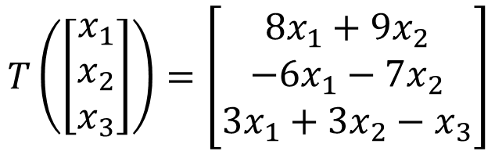


Diagonalization of Linear Operator
$$T\left(\left[\begin{aligned}x_{1} \\ x_{2} \\ x_{3}\end{aligned}\right]\right)=\left[\begin{aligned}8x_{1}+9x_{2} \\ −6x_{1}−7x_{2} \\ 3x_{1}+3x_{2}−x_{3}\end{aligned}\right]$$
Example 1:
det
-t
$$A=\left[\begin{matrix}8 & 9 & 0 \\ −6 & −7 & 0 \\ 3 & 3 & −1\end{matrix}\right]$$
The standard matrix is
-t
-t
⇒ the characteristic polynomial is −(t + 1)²(t − 2)
⇒ eigenvalues: −1, 2
Eigenvalue -1:
Eigenvalue 2:
$\text{B}\text{1}$=$\left\{\left[\begin{aligned}−1 \\ 1 \\ 0\end{aligned}\right],\left[\begin{aligned}0 \\ 0 \\ 1\end{aligned}\right]\right\}$
$\text{B}\text{2}$=$\left\{\left[\begin{aligned}3 \\ −2 \\ 1\end{aligned}\right]\right\}$
⇒ B₁ ∪ B₂ is a basis of R ³
⇒ T is diagonalizable.

Slide 22

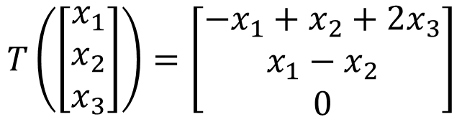

Diagonalization of Linear Operator
$$T\left(\left[\begin{aligned}x_{1} \\ x_{2} \\ x_{3}\end{aligned}\right]\right)=\left[\begin{aligned}−x_{1}+x_{2}+2x_{3} \\ x_{1}−x_{2} \\ 0\end{aligned}\right]$$
Example 2:
det
-t
$$A=\left[\begin{matrix}−1 & 1 & 2 \\ 1 & −1 & 0 \\ 0 & 0 & 0\end{matrix}\right]$$
The standard matrix is
-t
-t
⇒ the characteristic polynomial is −t²(t + 2)
⇒ eigenvalues: 0, −2
⇒ the reduced row echelon form of A − 0I₃ = A is
$$\left[\begin{matrix}1 & −1 & 0 \\ 0 & 0 & 1 \\ 0 & 0 & 0\end{matrix}\right]$$
⇒ the eigenspaces corresponding to the eigenvalue 0 has the
dimension 1 < 2 = algebraic multiplicity of the eigenvalue 0
⇒ T is not diagonalizable.

Slide 23











Diagonalization of Linear Operator
If a linear operator T is diagonalizable
$$D$$
$${\left[T\right]}_{\text{B}}$$
$${\left[v\right]}_{\text{B}}$$
$${\left[T\left(v\right)\right]}_{\text{B}}$$
simple
$$P^{−1}$$
Eigenvectors form the good system
$$P$$
$$B^{−1}$$
$$B$$
Properly selected
Properly selected
$$A=PDP^{−1}$$
$$v$$
$$T\left(v\right)$$

Slide 24
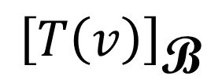
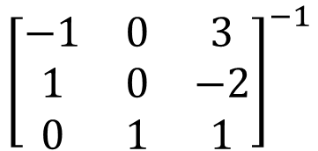
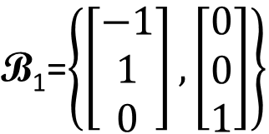
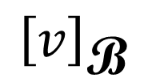
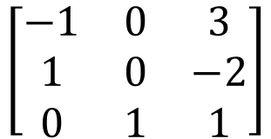
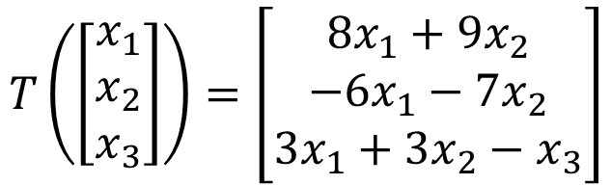

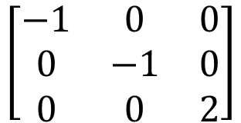

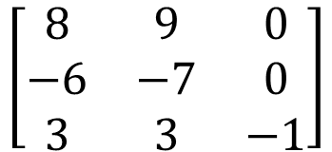
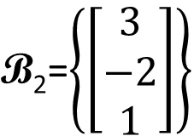

Diagonalization of Linear Operator
-1:
2:
$$T\left(\left[\begin{aligned}x_{1} \\ x_{2} \\ x_{3}\end{aligned}\right]\right)=\left[\begin{aligned}8x_{1}+9x_{2} \\ −6x_{1}−7x_{2} \\ 3x_{1}+3x_{2}−x_{3}\end{aligned}\right]$$
$\text{B}\text{1}$=$\left\{\left[\begin{aligned}−1 \\ 1 \\ 0\end{aligned}\right],\left[\begin{aligned}0 \\ 0 \\ 1\end{aligned}\right]\right\}$
$\text{B}\text{2}$=$\left\{\left[\begin{aligned}3 \\ −2 \\ 1\end{aligned}\right]\right\}$
$${\left[T\right]}_{\text{B}}$$
$${\left[v\right]}_{\text{B}}$$
$${\left[T\left(v\right)\right]}_{\text{B}}$$
$$\left[\begin{matrix}−1 & 0 & 0 \\ 0 & −1 & 0 \\ 0 & 0 & 2\end{matrix}\right]$$
$${\left[\begin{matrix}−1 & 0 & 3 \\ 1 & 0 & −2 \\ 0 & 1 & 1\end{matrix}\right]}^{−1}$$
$$\left[\begin{matrix}−1 & 0 & 3 \\ 1 & 0 & −2 \\ 0 & 1 & 1\end{matrix}\right]$$
$$\left[\begin{matrix}8 & 9 & 0 \\ −6 & −7 & 0 \\ 3 & 3 & −1\end{matrix}\right]$$
$$v$$
$$T\left(v\right)$$

